Slide 1
FLOW OF CONTROL: BRANCHING
Our member:
1.Amdulharis Yunuh 591431016
2.Ilham Jehmama 601431013
3.Sarif Kaday 591431001
4.Muhammat-atip weahama 591431008

Slide 2
Conditional Statements in C Language
Include :
1. if statement 2. if-else statement 3. nested if-else statement
Switch Statement

Slide 3
Conditional Statements in C Language
The if, if...else and nested if...else statement are used to make one-time decisions in C Programming, that is.
To execute some code/s.
Ignore some code/s depending upon the test expression.

Slide 4
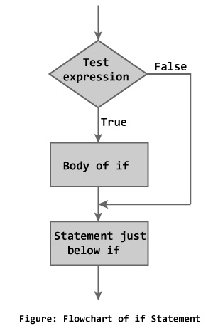
1.if statement
The if statement checks whether the text expression inside parenthesis () is true or not.
If the test expression is true, statement/s inside the body of if statement is executed but if test is false, statement/s inside body of if is ignored.

Slide 5
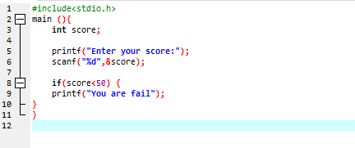
1.if statement

Slide 6
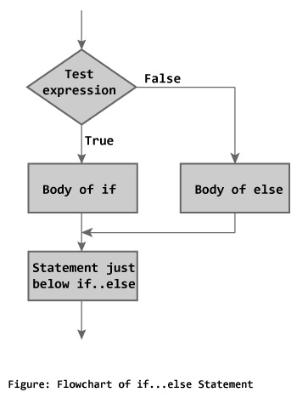
2. if-else statement
The if...else statement is used if the programmer wants to execute some statement/s when the test expression is true and execute some other statement/s if the test expression is false.

Slide 7
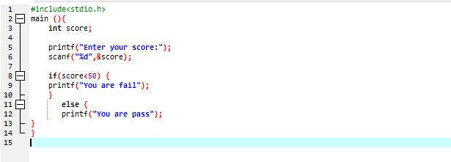
2. if-else statement

Slide 8
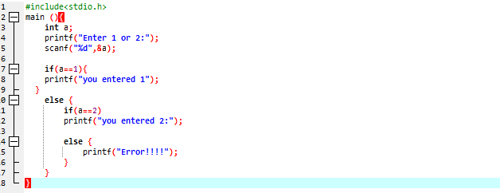
3. nested if-else statement

Slide 9
Switch statement
A switch statement allows a variable to be tested for equality against a list of values.
Each value is called a case, and the variable being switched on is checked for each switch case.

Slide 10
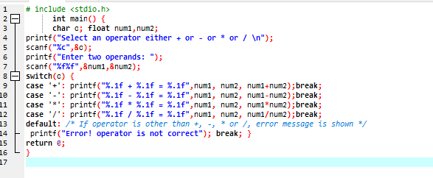
Switch statement

